Slide 1

UNIVERSITY OF DAR ES SALAAM
COLLAGE OF INFORMATION AND COMMUNICATION TECHNOLOGY.
COICT.

Slide 2
MOBILE APPLICATION REPORT
S/NO | NAME | IDENTIFICATION
1 | NTIMA, FRANCIS D. | 2021-01-00044
2 | MOBILE APPLICATION | MY TASK LIST
3 | COURSE | CERTIFICATE IN COMPUTER SCIENCE

Slide 3
PROBLEM.
Many people do not accomplish a lot of their task due to different reasons but one it is because they have a lot to do and they firget one of the tasks in their list in either they thougth it could be easy to remember and they do not accomplish to do them when they forget them.

Slide 4
SOLUTION.
MY TASK LIST APP tries to solve these problem by helping them to to list the tasks they want to do on the day or either on week on which when they forget they just have to revise on the phone app which is My Task list App

Slide 5
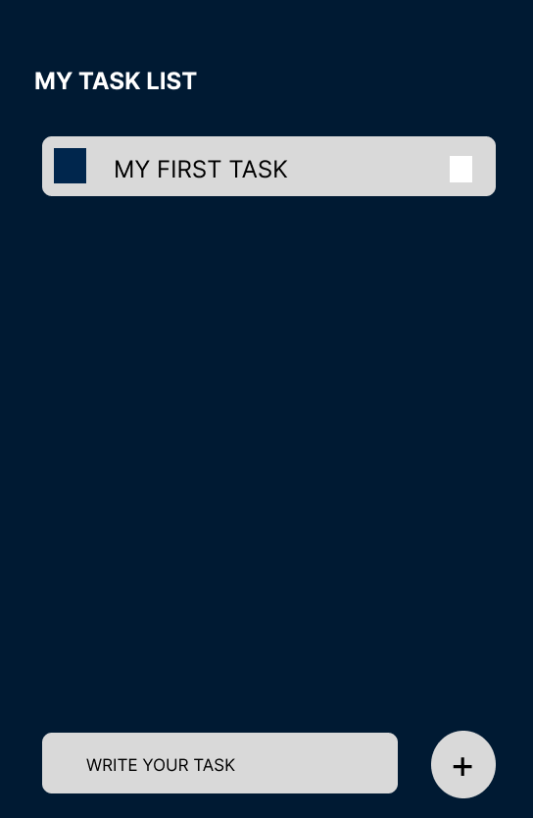
UI DESIGN APP
This design app is designed using FIGMA designimg tool.

Slide 6
TOOLS USED
React Native ( JavaSript Package).
Genymotion ( Simulator package).
Virtual box ( To run Simulator ).
Expo-cli ( React native package ).
expo app ( app to run application on device ).

Slide 7
CONCLUSION
The app is complite done and you can view the source code on my github via my public repository.
Github link
https://github.com/VloneMe/My-Task-List

